Slide 1
Hazard Alert and situation awareness APP

Slide 2
Applications
Violence against aid workers
Flood hazards
Critical infrastructure disaster
Human trafficking
Bio hazards
…

Slide 3

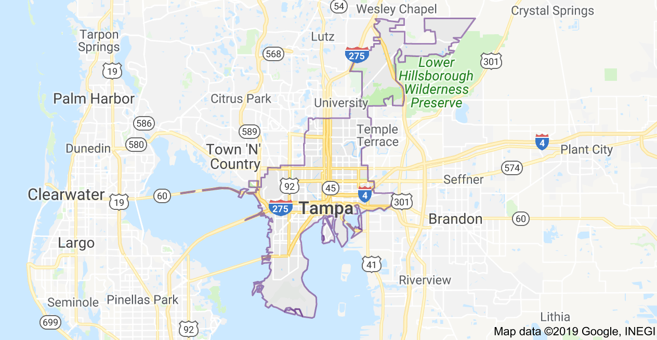
Flood
CI
Biohazard
…
Qualifiers
severity
Hazard type
Location
Time stamp
Description
Photo
Originator
GPS
Manual
Type text
Output
Shared hazard map
situation awareness
Planning
response

